Slide 1
Hauwa Bappa ahmed 25a-sms-bua-0252
Digital entrepreneurship 202
Data analysis student performance dashboard

Slide 2
the dataset explaination
The excel sheet is about school data on student’s gender, parental education, lunch and examination scores on reading, writing and math. The excel sheet explains the data of each student

Slide 3
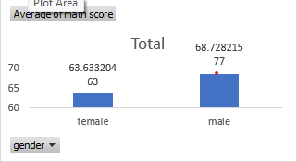
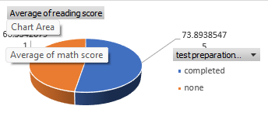
Question one and two
Average Math Score by Gender
Average Reading Score by Test Preparation

Slide 4
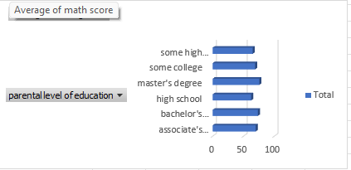
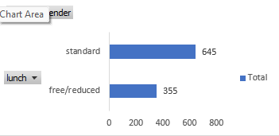
Questions 3 and 4
Average Writing Score by Parent Education
. Number of Students by Lunch Type

Slide 5
findings
Males students are better at math
Most students do the standard lunch type
Students who prepared for the reading test did better
There are 1000 students in the school
Students are better at reading based on the dataset

